Slide 1


Prediction the Most Valuable NBA
Player for the 2021-2022 season
DATA SCIENCE PROJECT

Slide 2


What is the Most Valuable NBA
Player?
The National Basketball Association Most Valuable Player Award (MVP) is an annual
National Basketball Association (NBA) award given since the 1955–56 season to the
best performing player of the regular season. The winner receives the Maurice
Podoloff Trophy, which is named in honor of the first commissioner (then president) of
the NBA, who served from 1946 until 1963

Slide 3


Main data science process steps of the project
Data collection of NBA players from 1998 to the current year
Data cleaning, data preparation
Exploring Data
Data preprocessing. Feature engineering
Modeling predictive machine learning model

Slide 4

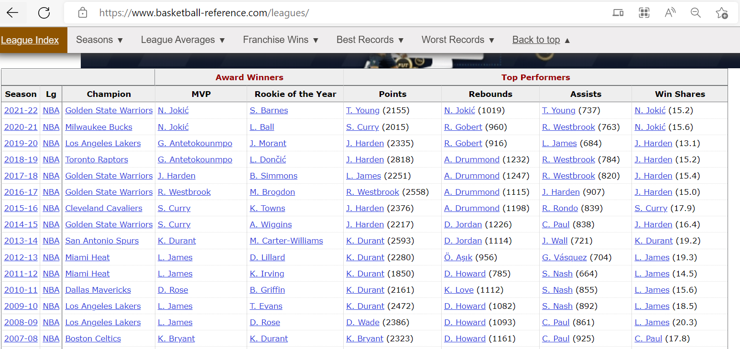
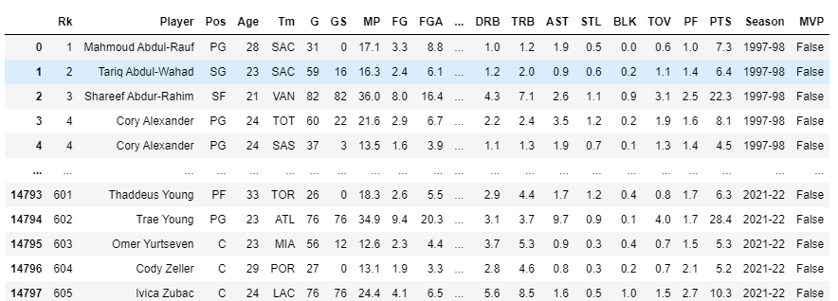
Data collection of NBA players from 1998 to 2022
Data collection carried out in one stages:
Collection data from https://www.basketball-reference.com/ using the Web crawling

Slide 5
Data cleaning,
data preparation
Data cleaning and data preparation carried out in several stages:
Drop duplicates
Fill missing values with average meaning
Removed extra characters in the dataset

Slide 6
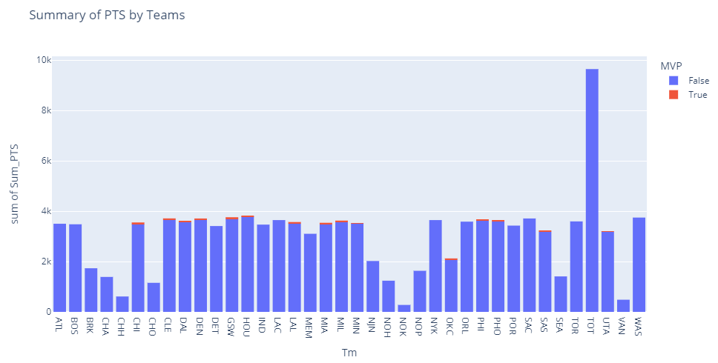
Exploring Data
Data exploration was carried out by visualization and application of standard descriptive functions of the pandas library. For analysis, we took mainly the PTS (the number of points scored) indicator.

Slide 7
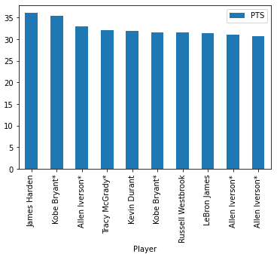
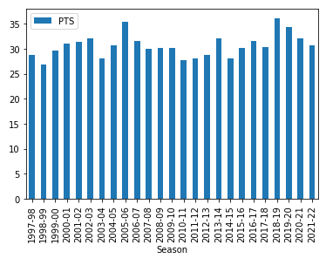
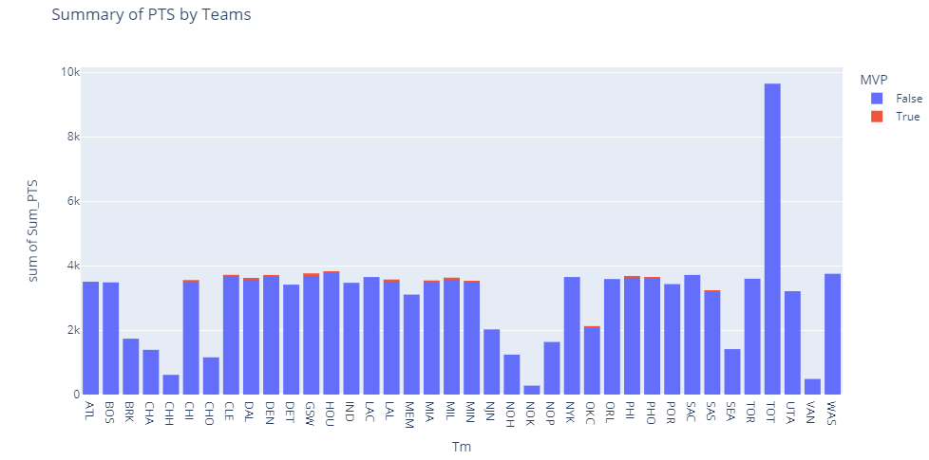
Exploring Data
Visualized the following points:
Sort players with more than 70 Games per game
Top 10 players by total PTS
Total number of PTS by Season
Summary of PTS by Teams considering status of MPV players
Correlation between variables and target value

Slide 8
Data preprocessing. Feature engineering
Data preprocessing is the process of cleaning and preparing the raw data to enable feature engineering. It has traditionally been an important preliminary step for the data mining process:
- Filter the columns will be used for MVP prediction
Splitting the data into training and test sets
Splitting Features and the Target Label

Slide 9
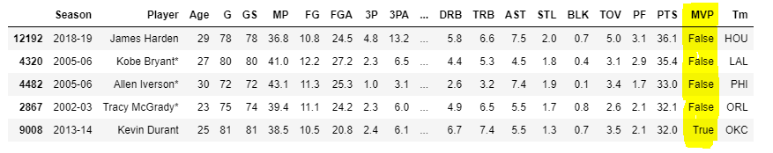
Modeling predictive machine learning model
As part of this project, we needed to solve a classification problem for machine learning.
This task is a supervised task, since the dataset was marked with labels at the beginning of the project
To solve this problem, we chose KNN algo. It is a type of Supervised Machine Learning.

Slide 10
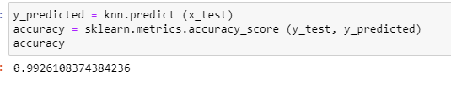
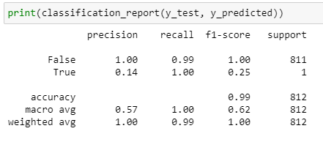
Modeling predictive machine learning model
The final accuracy of the "KNN algo" model is 99%.
To summarizes how successful is our classification model we measured the evaluation metrics for classification:
Precision
Recall
F-score

Slide 11
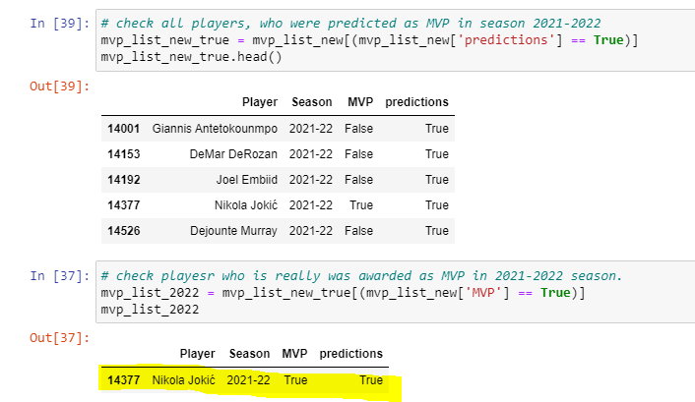
Modeling predictive machine learning model
Now, the most important part is the prediction for the season 2021-2022
The resulting table shows that the model showed a predictive result, for example, Nikola jokic as a player who actually received the MVP status

Slide 12
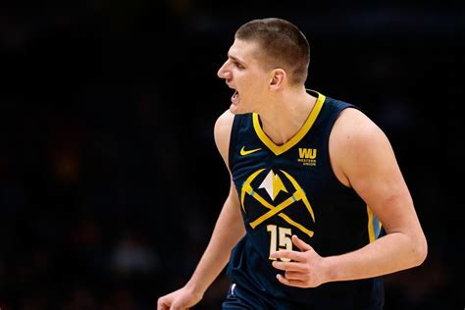
Conclusion
The built model showed correct results and helped predict new players who got the MVP status in the current season. One of these contenders, according to the resulting model, was Nikola jokic.
Thus, the predictive model has shown
its validity and correctness!
Thank you for watching !
Bar machluf
Yovel hadad

